Slide 1

LEARNING C#
September 2017

Slide 2
Agenda
Variables and Data Types
Control Flow
Classes and Object Hierarchies
LUNCH
Interfaces
Errors and Exceptions
Generics
Notes:
Sort out timing for lunch
Cover: Toilets breaks, tea and coffee breaks, questions, Koans

Slide 3
Some expectations
Introduction to key concepts in C# that need to be understood
Some coding demos, illustrating the concepts.
Some practical exercise for you to do – Getting your feet wet with some Koans!
Cannot cover all the topics in C#. We will concentrate on the basics!
More advanced topics will need to be discovered by you.
You should continue learning after this. Best way is to practice and ask questions! ☺

Slide 4
Who are you?
Learn by repetition
Notes:
Name and university/college game – I do all the repetition

Slide 5
VARIABLES
Think of them as buckets. Yep, that’s right - buckets. Buckets of….?

Slide 6

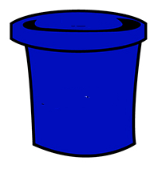
Variables
27
age
They are like buckets, with a name
Each named bucket, can hold something
But, they can only hold a specific type of something. You need to declare what that type is
true
isTooOld
Notes:
In code, demonstrate
You can access the something in the bucket in your code by using the variable name
You can replace the something in your bucket, with another something (of the same type, of course)
Cover the assignment operator

Slide 7
Over To You!
Complete the following Koans
About Asserts
About Variables
Wait! First a lesson on asserting yourself
Notes:
Demo asserts for them. Assert.True, False, Equals(expected, actual) should be enough
Demonstrate running the Koans project, and
Finding the offending line of code
fixing the first 2 exceptions

Slide 8
DATA TYPES
THE STRONG vs the weak

Slide 9
.NET is statically typed
"For a language to be statically typed, it means that the types of all variables are known or inferred at compile time. A strongly typed language does not allow you to use one type as another"
Basically, you can’t put the wrong shaped something into a bucket in .NET. The compiler will complain!

Slide 10
Primitives data types, the numbers
Some common primitive types
Using literal (specific) values
var aBool = true; var anInt = 2; var aDouble = 2.0D; var aFloat = 2.0F; var aString = "hi there"; var aChar = 'B';
C# Type | Common operators
int (short, long) | Numerical operators + - * / %
double (decimal, float) | Numerical operators + - * / %
bool | Logical operators && || !
string | +
char
https://docs.microsoft.com/en-us/dotnet/csharp/language-reference/keywords/built-in-types-table
Notes:
Mention the ones in brackets (are similar but have different ranges due to storage size)
Go through the operators – specifically mod, logical, and string concat
Mention the suffixes in the literals

Slide 11
String literals
Double quotes surround the text | "Sausage Egg Cheese"
What if I want double quotes in the string? | Put two double quotes: "He said ""Say What?! """ Or escape them: "He said \"Say What?!\""
How do I insert special characters, like newlines, and tabs | "Here is a new line: \n and here is a tab: \t "
That makes it difficult to read. Verbatim strings! | @"This is a verbatim string with any special character in it that can go over multiple lines!"
Old skool formatting, with positional parameters | string.Format("I am {0} {1}", nameVar, surnameVar)
Hipster interpolation! | $"I am { nameVar} { surnameVar }"

Slide 12
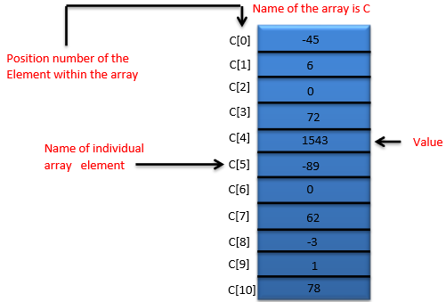
Arrays
Built in type, that can hold many things of the same type
They have a fixed length, defined when you create them
Indexable – zero based, watch out!
Access items through the positional index
Can initialise values in the array when defining the array
c
var myPets = new string[] {"tigger", "sandy", "mischief", "whiskers"}; Console.WriteLine(myPets[0]); Console.WriteLine(myPets[4]); myPets[2] = "monty"; myPets[0] = new DateTime(1977, 4, 4);
Notes:
Go through the code, asking them what will happen with each line

Slide 13
Reference and Value types
Value Types
The bucket is big enough to hold the whole thing it.
Reference Types
There are actually 2 buckets – only one with a name though. WTF?!
The Named Bucket*: teeny-tiny named bucket, which just holds a number: an address to a position in memory where The Data Bucket can be found
The Data Bucket*: Holds all the data for the thing you are storing
* Warning These names are made up, to continue with the bucket metaphor! They are not industry recognized terms ☺

Slide 14


Reference types – a picture!
97
12
dadsCar
myCar
(bucket is located at position 12 in memory)
(bucket is located at position 97 in memory)
Notes:
Point out that the little buckets have the names, and just a pointer to where the actual data is (in the bigger bucket!)

Slide 15
Over To You!
Complete the following Koans
About Floats
About Strings
About Arrays
Notes:
Demo asserts for them. Assert.True, False, Equals(expected, actual) should be enough

Slide 16
CONTROL FLOW
Errr.. What happens next?!?!

Slide 17

Branching
If statements
switch statements
if (booleanExpression) { // Go here if true } else { // Go here if false }
var value = 6; switch (value) { case 1: case 4: // Go here when 1 or 4 break; case 2: // Go here when 2 break; default: // Go here when no previous cases match break; } return value;
Conditional operator
var result = booleanExpression ? valueIfTrue : valueIfFalse;
Notes:
Examples, showing assignment operator vs equals in the booleanExpression
Discuss breaking in the switch

Slide 18
Looping and repeating
foreach loop
Loop over each element in a set
var numbers = new[] {1, 2, 3, 4, 5}; foreach (var number in numbers) { // do something with the number }
while loop
Repeat statements while something is true
bool booleanExpression; while (booleanExpression) { // execute these statements // .. }
for loop – old skool
Manage a looping variable to determine when to stop looping
for (initial; booleanExpression; afterEachLoop) { statements
}
do loop
Repeat statements while something is true
do { // execute these statements // .. } while (booleanExpression);
for (int counter = 1; counter == 5; counter++) { Console.WriteLine(counter); }
Notes:
Subtle difference between WHILE loops and DO loops – what happens if the expression is false at the beginning?

Slide 19
Jail break!
break terminates the loop, and moves to the next statement
continue terminates only
the current iteration
var myPets = new[] {"tigger", "sandy",
"mischief", "whiskers"}; for (var index = 1; index < myPets.Length; index++) { Console.WriteLine(myPets[index]); break; }
var myPets = new[] {"tigger", "sandy",
"mischief", "whiskers"}; for (var index = 1; index < myPets.Length; index++) { continue;
Console.WriteLine(myPets[index]); }
Notes:
What does each of these snippets output?

Slide 20
Functions / Methods
Group a bunch of statements into together
Calling the function, will execute those statements
Can send information to the function, to be used by the statements
Can return some information
Have a method signature, made up of return type, Name, Parameter Types and order
public virtual Coffee MakeCoffee(string customerName, int numberOfSugars, bool useTakeAwayCup)
{
// multiple statements, that execute in the scope of this method
}
Notes:
Examine the method signature. What is and is not included in the definition of the signature? Demonstrate different variations of the above, and method overloading.

Slide 21
Working with functions
Must specify a return type, and return something of that type using the return keyword
Can opt to not send anything back, specifying void as the return type
Can have data sent into it, via parameters
var name = "Paulo"; var beverage1 = MakeCoffee("Ian", 0, true); var beverage2 = MakeCoffee(name, Int32.MaxValue, false);
public virtual Coffee MakeCoffee(string customerName, int numberOfSugars, bool useTakeAwayCup = true) { return new Coffee {Sugars = numberOfSugars, IsTakeAway = useTakeAwayCup, Name = customerName}; }
Notes:
sending variables as parameters
Order of parameters
default parameter values

Slide 22
Over To You!
Complete the following Koans
About Control Statements

Slide 23
CLASSES
As used in OOP (Object Orientated Programming)

Slide 24
Classes – what we will cover
Class definitions and object instances
Creating and destroying object instances
Properties and methods
Accessibility
Inheritance
Static members

Slide 25
What’s OOP about?
It is a way to model things in the program
Developers model things as Objects.. where an Object has
some state (i.e. data it holds about itself)
some behaviour
Programs are then made up of objects that can then interact with each other

Slide 26
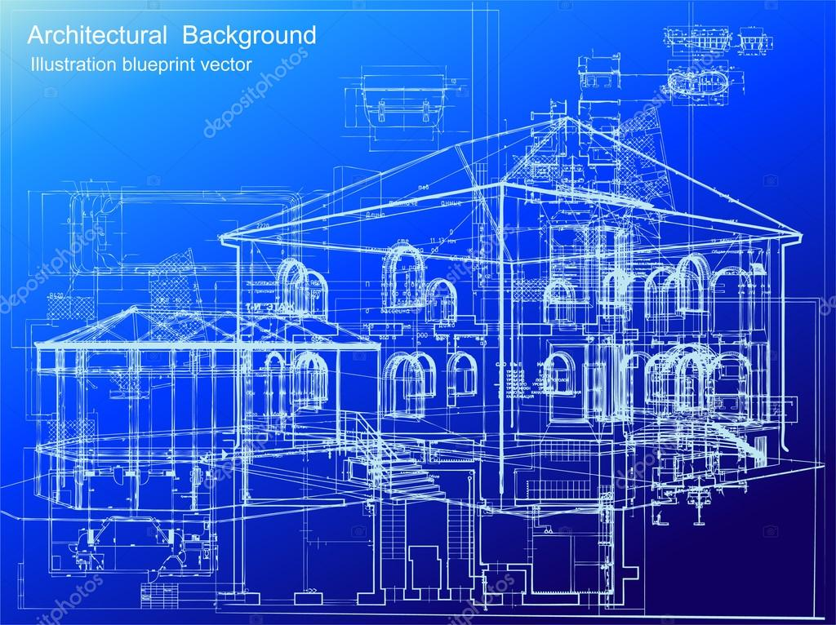

A Neighbourhood of Houses
This is a CLASS, representing a house
You define this when coding
(CLASS and TYPE can almost be used interchangeably)
These are OBJECT INSTANCES,
Created when your program is running

Slide 27
Code sample – define, and create 2 houses
// The blue print for a house
public class House { private int _numberOfWindows; public House() { _numberOfWindows = 2; } }
public static void Main(string[] args) {
// create some houses! var darkHouse = new House(); var brightHouse = new House(); }

Slide 28
Constructing Houses
House myDreamHouse;
myDreamHouse = new House();
public class House { private int _numberOfWindows; // THE CONSTRUCTOR
public House() { _numberOfWindows = 4; } }
12
myDreamHouse
Notes:
Click through, examing the code about to execute, and imagining (in terms of buckets) what is going to happen
Discuss the new keyworkd, and constructors
demo passing data into a constructor, and setting properties when creating objects

Slide 29
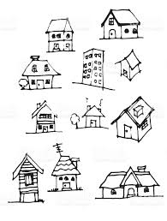
Not every house is equal
Houses can have different state, held within properties and fields.
# of floors
# and shape of windows
Main material built with
Behaviour of a house may be different dependant on the state. Behaviour is defined in methods
If the wind blows, the house of cards and house of bricks behave differently
Notes:
Go through properties, fields and methods.

Slide 30
Who can do what to your house?
Some functionality may only be accessible to the house itself. It is private functionality.
private bool IsTempBelowThreshold() { }
Some functionality may be accessible to other objects that interact with the house. It is public functionality, and essentially contributes to the interface for the class.
public void RingDoorbell() { }

Slide 31
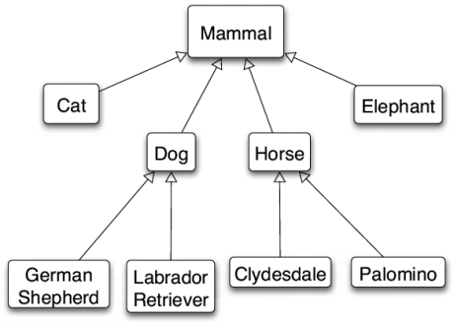
Defining specialized houses (ahem.. mammals)
Define a more specialized class using by inheriting from a base class
The subclasses inherit the state and behaviour from the base class, but can
Add behaviour and extra state
Override the base/super classes behaviour (if it is marked a virtual)
Abstract classes are partially complete classes that cannot be instantiated (via new).
Notes:
Go through the terms Base / Super class.. Subclass/child class. Use Dog as an example.
Discuss
Mammal.Breathe()
Mammal.SoundOff();
Dog.IsHypoallergenic()
LabradorRetriever.Retrieve()

Slide 32
Inheritance code example
public abstract class Mammal { private int oxygenLevel; public virtual void Breathe() { this.oxygenLevel += 10; } } public class Dog : Mammal { public override void Breathe() { base.Breathe(); Drool(); } public void ShowPuppyDogEyes() { } private void Drool() { } } public class Elephant : Mammal { public void Trumpet() { } }
Notes:
Do AboutInheritance Koan after this.

Slide 33
Who needs an object instance?!?
Data or behaviour can be defined on the class/type. Think having some data stored on the architectural blueprint itself
Defined with the keyword static, and is accessed without an object instance`
public class House { public static int IdealRoomTemperature { get; set; }
}
House.IdealRoomTemperature = 28;
Notes:
Slight shift back to procedural programming, but with organisation in place.
Mention that classes can also be static.

Slide 34
The Tenets of OOP
Encapsulation
Inheritance
Polymorphism
Abstraction

Slide 35
Over To You!
Complete the following Koans
AboutInheritance

Slide 36
INTERFACES
What does that object look like?
How do I work with it?

Slide 37

What is an interface?
What is an interface, in the general world?
Any examples of things that have an interface?
Define the interface for your assigned object
Present back to the other teams
Check your understanding of the other teams interface definitions
Can different things, have the same interface? Examples?
What makes up the interface for an object?
Notes:
Choose Scribe
Write down somethings that have an interface. Prefer odd things (other than phone, music player, TV etc)
(
Or use this list, and draw one out of a hat?
ATM
Car,
Bank Account,
Power Socket
)
Ask them to thing about what you can
tell the object to do
And what state it can has (that can maybe be modified?)
Break into 4 teams, give each one an object that was defined
* They need to present back with the definition of the interface for that thing.
Ask other teams to ask them questions about their interface (can the other teams understand their interface)

Slide 38
Code against interfaces
An interface ..
is by default public (otherwise what is the point)
Specifies the method signatures and properties, so users know how to use an object that implements that interface
By convention, starts with a capital I
Classes can implement many interfaces
The term concrete class is used when a specific type is used
Coding against interfaces (instead of concrete types) allows different types of objects to swapped in, as long as the object implements the expected interface!
public IDog Purchase() { var dog = new LabradorRetriever(); return dog; }
Notes:
Demo a simple interface (choose one from the previous exercise)
Create a class that implements it, and auto generate methods
Create something that expects that interface

Slide 39
ERRORS
Oh $%^&!.
What do we do now??!?!

Slide 40
Handling Errors
We try execute a section of code.
If an error occurs while executing that code, an Exception is thrown.
We can catch that Exception, and handle it elegantly
If we don’t catch that Exception, it gets bubbled up through the call stack
If it gets bubbled all the way to the entry point of your application and it is not handled there, the application dies. DEAD. KAPUT.
try { // do a bunch of work } catch (ArgumentOutOfRangeException e) { // handle elegantly } catch (Exception e) { Trace.Write(e.Message, e.Source); throw; }
Notes:
Talk about catching different types of exceptions
Talk about the call stack
Ask what happens with the throw in the example, and why would we re-throw an exception we have caught?
Show innerException property

Slide 41
Guess what happens
!!
myCar.SwitchOn();
myCar = myDadsCar;
myDadsCar = new Car();
97
97
myCar
myDadsCar

Slide 42
Null. A Four Letter Word.
Find out all about it, in the AboutNull Koan

Slide 43
Over To You!
Complete the following Koans
About Null

Slide 44
GENERICS
code that can work with lots of different types of TYPES

Slide 45
Why Generics?
Specialized code – i.e. code that is tightly coupled to specific types that it works with – doesn’t foster re-use of code
By making code more generalized – it can be re-used in more situations
And now for an example
Notes:
VHS Controller
Employee at Blockbuster
didn’t like rewinding the taps, then fast forwarding them to find a good spot to have them ready for the next customer (after the warnings and other logos etc), but on the BlockBuster logo
#
Show them the code, that handles VHS machines.
Tell them that the boss wants to expand, and also handle the beta market.
And unlike the real blockbuster, he had some vision and wanted this work to be able to handle more types of machines (like maybe streaming devices!)
using System; namespace Bootcamp2017Demos.GenericsDemo { public class PrepareVideo { public void SeekMovieStart(VHSMachine vhsMachine) { // rewind to the beginning var hasRewoundToBeginning = false; do { hasRewoundToBeginning = vhsMachine.Rewind(TimeSpan.FromMinutes(1)); } while (!hasRewoundToBeginning); // start playing the video vhsMachine.Play(); // fastforward bit by bit to find blockbusters logo while (!NotAtBlockbusterLogo(vhsMachine)) { vhsMachine.FastForward(TimeSpan.FromSeconds(5)); } // Stop the machine! vhsMachine.Stop(); } private bool NotAtBlockbusterLogo(VHSMachine vhsMachine) { var currentPic = vhsMachine.CurrentImage; // examine the current pic to see if it is the blockbuster logo return true; } } public class VHSMachine { public VHSTape CurrentVhsTape { get; } public Image CurrentImage { get; } public bool Rewind(TimeSpan distance) { return true; } public bool FastForward(TimeSpan distacSpan) { return true; } public void Play() {} public void Stop() {} } public class Image { } public class VHSTape { } }

Slide 46
Generics – Fun Facts
You can create generic classes or methods.
Can constrain the generic parameter, so only a limited set of types will be allowed
Can have more than one generic parameter
Common Generic Types used are the container types
List<T> Dictionary<Tkey, TValue>

Slide 47
Over To You!
Complete the following Koans
About Generic Containers
Notes:
This is a long one, so probably they should do by themselves

Slide 48
Enums and Flags
Notes:
Demo an enum, and a flags enum
Enum DaysOfTheWeek {
Monday, through Sunday
}
[Flags]
Public Enum Disposition {
Positive
Sunny
Miserable
Whiney
Lackadaisical
}
CalculateStars(Disposition) {
}

Slide 49
Lamdas
Notes:
Lamda = anonymous function
Demo the structure of a lambda
Passing lambdas into another function, and invoking them
Using a lamda in some linq

Slide 50
Extention Methods
Notes:
Lamda = anonymous function
Demo the structure of a lambda
Passing lambdas into another function, and invoking them
Using a lamda in some linq

Slide 51
Over To You!
Complete the following Koans
About Lamdas
About Methods
Notes:
This is a long one, so probably they should do by themselves

Slide 52
UNIT TESTS
Umm.. we supposed to test our code works??

